Slide 1
Security recommendations
for Blue Ink
Martin Ponce, ID 10371381
CSI1101 Computer Security
ES Off-Campus
Tutor: Patryk Szewczyk

Slide 2
Introduction

Slide 3
Introduction
This presentation will recommend mitigation strategies for the following security issues found during the analysis of Blue Ink’s VM image
Anti-malware
Patch management
User and device management
User practices
It is assumed that Blue Ink has at least one server with Microsoft Server 20xx installed which is capable of running and configuring Active Directory Domain Services

Slide 4
Anti-malware

Slide 5
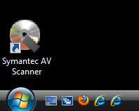
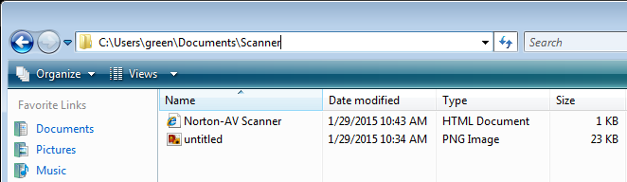
Security issue: Fake anti-virus
Origin unknown
Potentially installed through malware propagation
Offers zero protection
Delete desktop shortcut and supporting files immediately
Replace with legitimate anti-virus application

Slide 6
Recommend: Kaspersky Endpoint Security for Business Advanced 10.2
Variants
Core
Select
Advanced
Total
Advanced variant includes patch management features
Recommended to manage patching of Blue Ink’s devices
Highest scoring patch manager according to AV-TEST
High scoring anti-malware according to AV-TEST

Slide 7
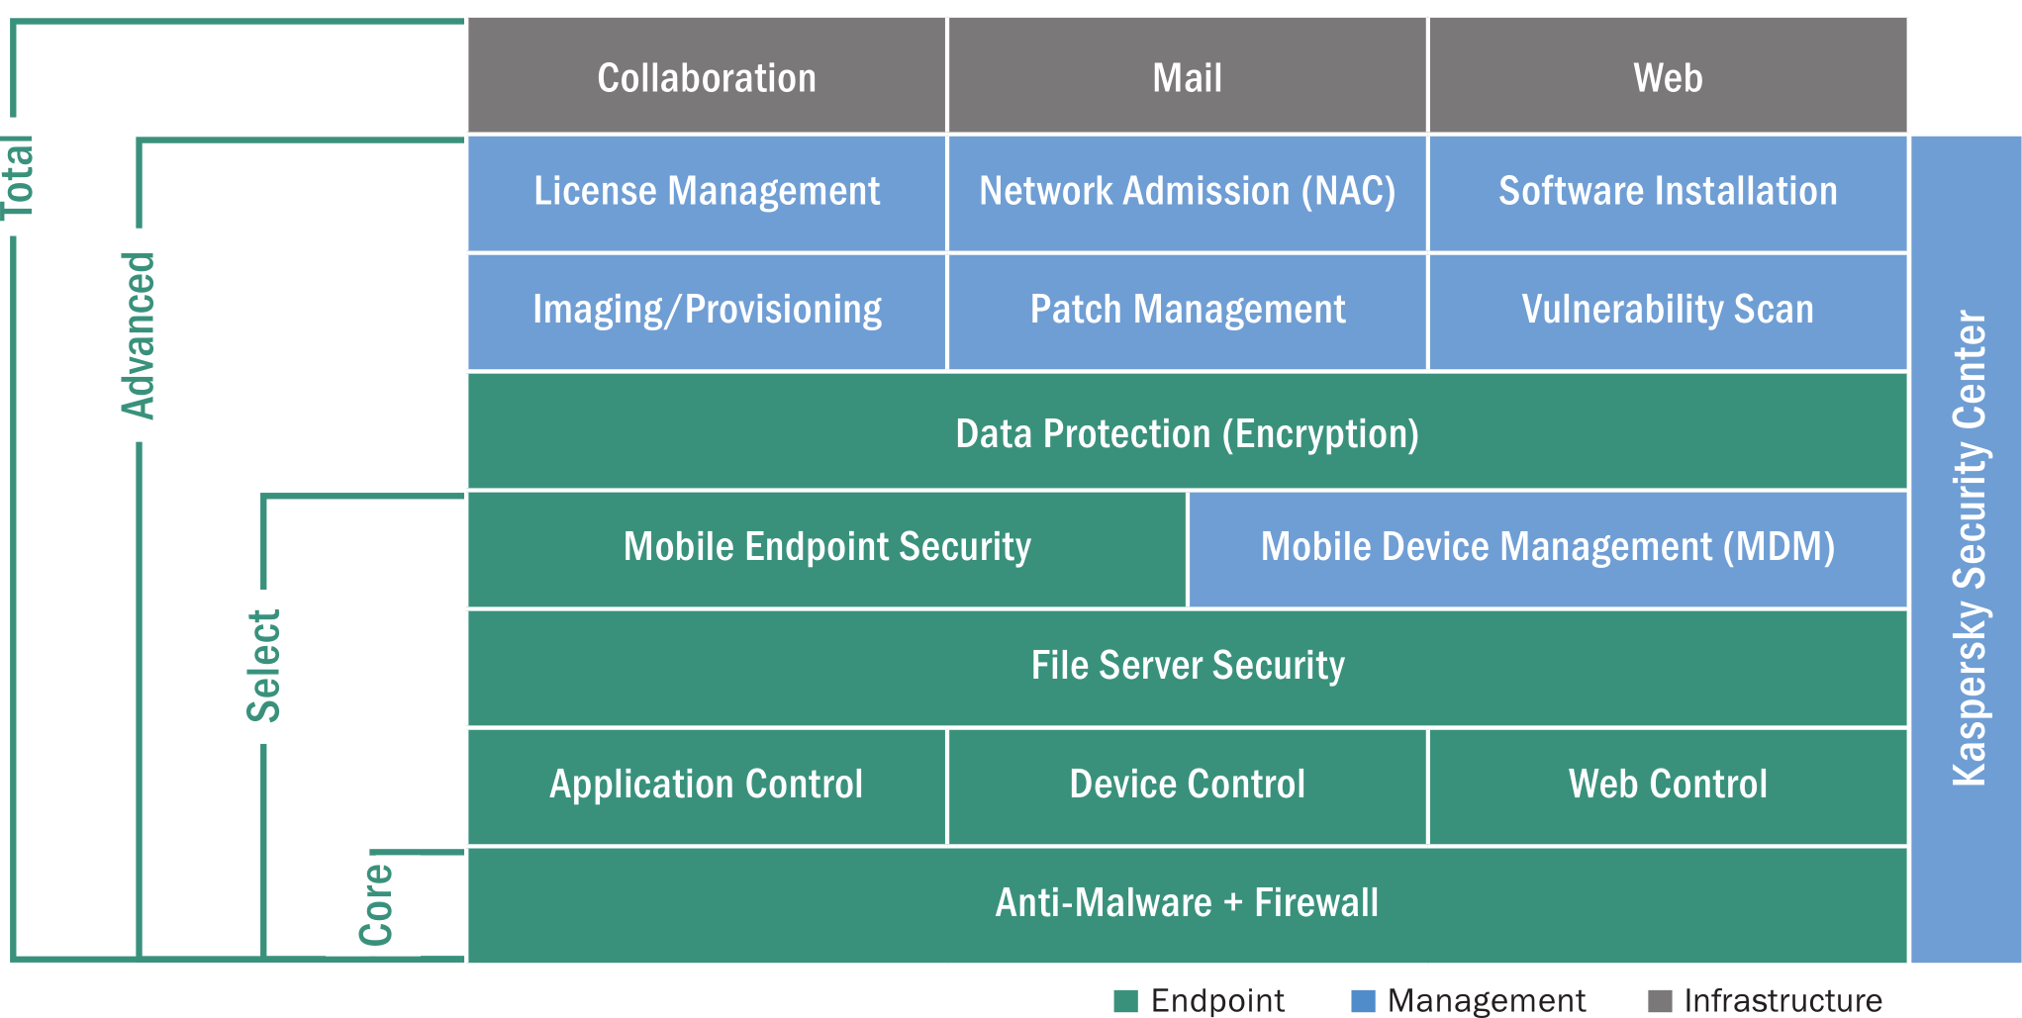
Endpoint Security 10.2 variants overview
(Kaspersky Lab, 2013a, p. 1)

Slide 8
Kaspersky Endpoint Security for Business Advanced 10.2:
AV-TEST compared leading business anti-virus products in December 2014
Kaspersky Endpoint Security 10.2 scored among the highest in protection, performance and usability
Note: Tests for Windows Vista not available, although is compatible
Windows 7 results shown as closest analogue

Slide 9
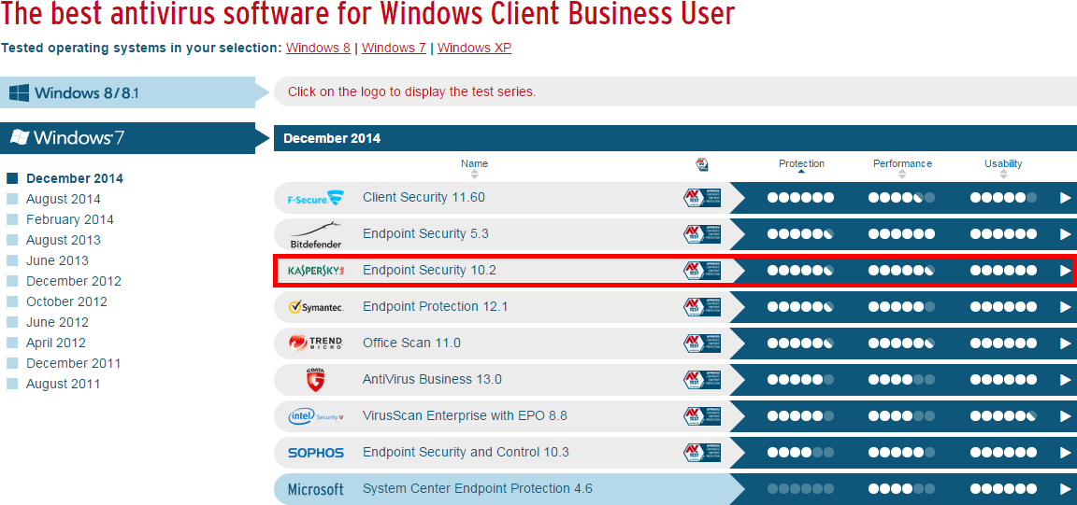
AV-TEST Business Anti-virus comparisons
(AV-TEST, 2014a)

Slide 10
AV-TEST Kaspersky Endpoint Security results
Categories | Tests | November | December | Industry Average
Protection | Against 0-day malware attacks, inclusive of web and email threats (real world testing) 153 samples | 97% | 100% | 92%
 | Detection of widespread / prevalent malware discovered in the last 4 weeks (AV-TEST reference set) 12,327 samples | 100% | 100% | 97%
Performance | Use cases: visiting websites, downloading software, installing and running programs and copying data 5 samples | 1s |  | 2s
Usability | False warnings or blockages when visiting websites 500 samples | 0 | 0 | 0
 | False detections of legitimate software as malware during a system scan 425,612 samples | 0 | 0 | 1
 | False warnings concerning certain actions carried out whilst installing and using legitimate software 38 samples | 0 |  | 0
 | False blockages of certain actions carried out whilst installing and using legitimate software 38 samples | 0 |  | 0
* Results based on Windows 7 client (AV-TEST, 2014b)

Slide 11
Patch management

Slide 12
Security issue: OS / application vulnerabilities
Application | CVE | Description
Vista SP0 | CVE-2008-0951 | Auto-run vulnerability
 | CVE-2007-5133 | Denial of Service overflow
Internet Explorer 7 | CVE-2015-0067 | Remote memory corruption
 | CVE-2013-3918 | Active-X Control vulnerability
Firefox 8.0 | CVE-2014-1522 | Remote arbitrary code execution
 | CVE-2014-1532 | Heap memory corruption
Adobe Reader 6.0.1 | CVE-2011-2462 | Remote arbitrary code execution
 | CVE-2009-3959 | Arbitrary code execution via malicious PDF
Mitigate with regular and scheduled patching of OS and applications

Slide 13
Recommend: Kaspersky Endpoint Security for Business Advanced 10.2
Includes patch management features
AV-TEST compared leading business patch management software in June 2013
Kaspersky Security Center 10.1 scored highest for most tests
Note: Security Center 10.2 included in Kaspersky Security for Business Advanced 10.2
Provides efficient way to manage patching on Blue Ink’s devices connected to network

Slide 14
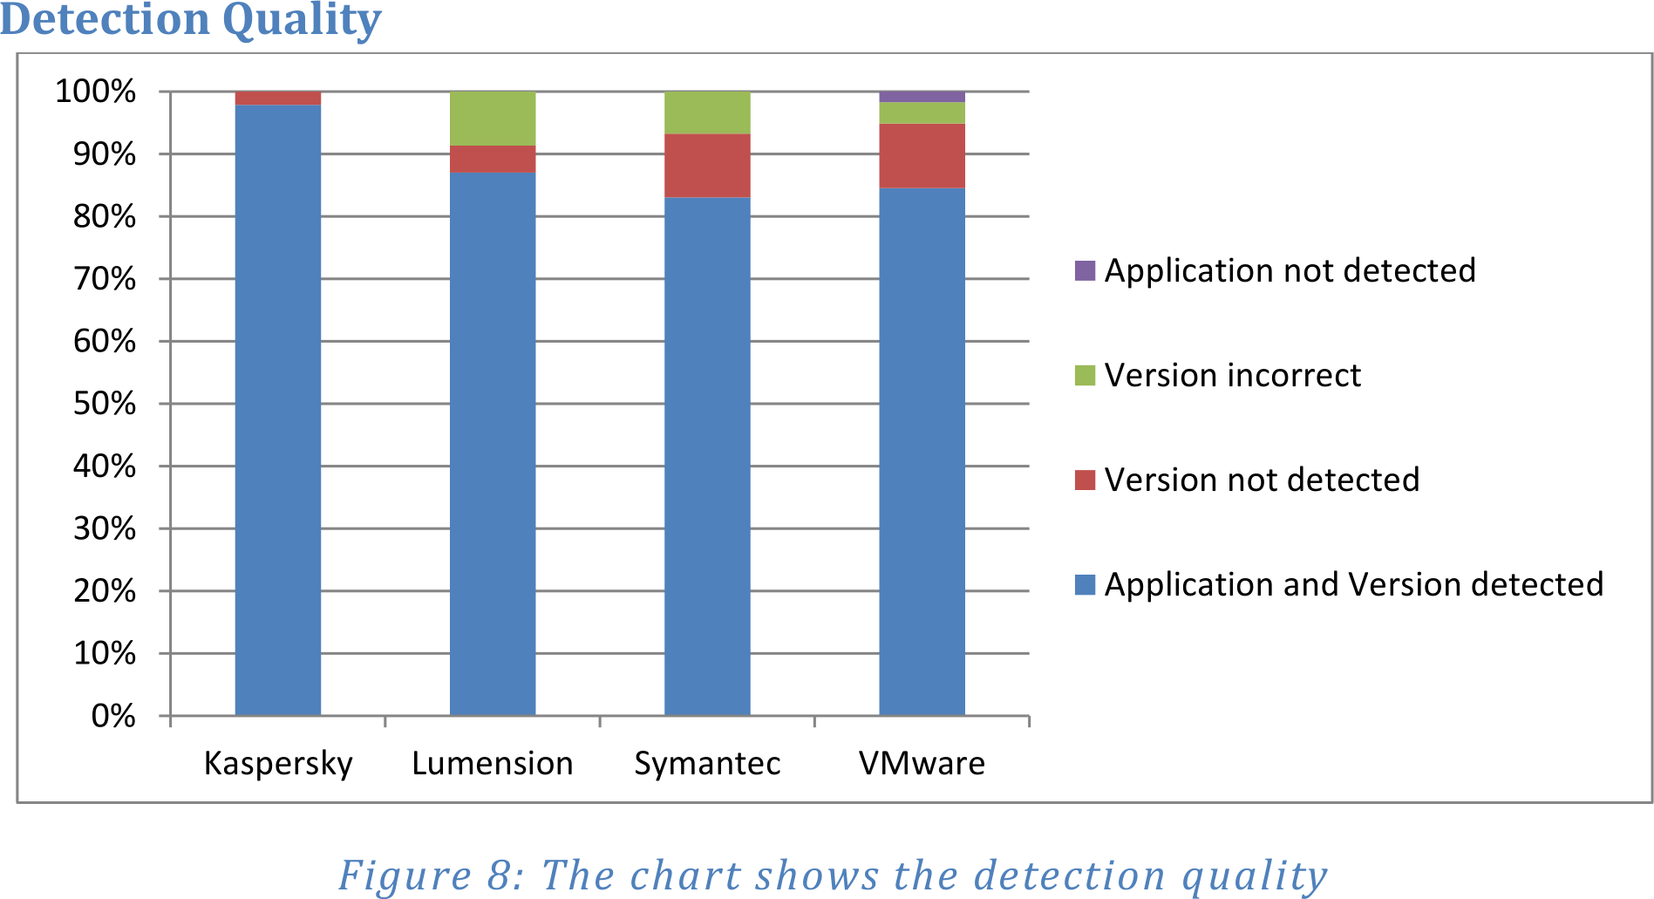
AV-TEST Kaspersky Security Center 10.1 results
Vendor | Supported apps | Detection quality | Reaction rate | Install barrier | Microsoft update support
Kaspersky | ~200 | ~98% | ~4 days | 0% | WSUS
Lumension | ~80 | ~87% | ~11.5 days | ~5% | None
Symantec | ~140 | ~82% | ~4.5 days | ~21% | None
VMWare | ~190 | ~85% | ~4 days | ~9% | None
(AV-TEST, 2013, p. 7)

Slide 15
Advantages: Kaspersky Endpoint Security for Business Advanced 10.2
One software package to address anti-virus and patch management needs
Both features scored highly by AV-TEST
Mitigate vulnerabilities in OS/applications with security patches
Other anti-virus apps reviewed by AV-TEST do not include patch management features
ie. BitDefender
Provides other features such as firewall and encryption

Slide 16
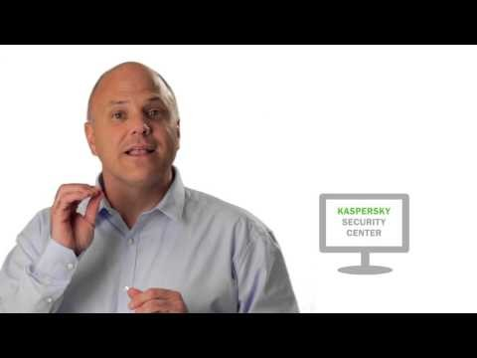
Video: Kaspersky Endpoint Security for Business Advanced (Kaspersky Lab, 2013b)

Slide 17
User and device management

Slide 18
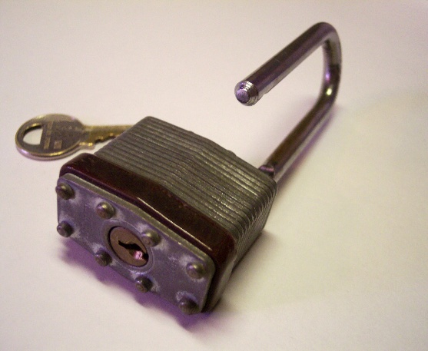
Security issue: Non-existent user / device security policies
Blue Ink computers do not have any security policies
Logs user automatically into an administrator account without authentication
Screensaver not password protected
User Access Control (UAC) disabled
(cohdra, 2005)

Slide 19
Recommend: Active Directory Domain Services (Microsoft, 2007)
Configure Windows 20xx Server as Active Directory Domain Controller
Populate user, group and device databases
Configure group access rights (Microsoft, 2005a)
Reserve admin rights to IT support staff only
Enforce security settings via group policies
Screenserver password protection (Microsoft n.d.)
Enable UAC (Microsoft, 2007)
Password strength policies (Microsoft, 2012)
Lock account after failed attempts (Microsoft, 2005b)

Slide 20
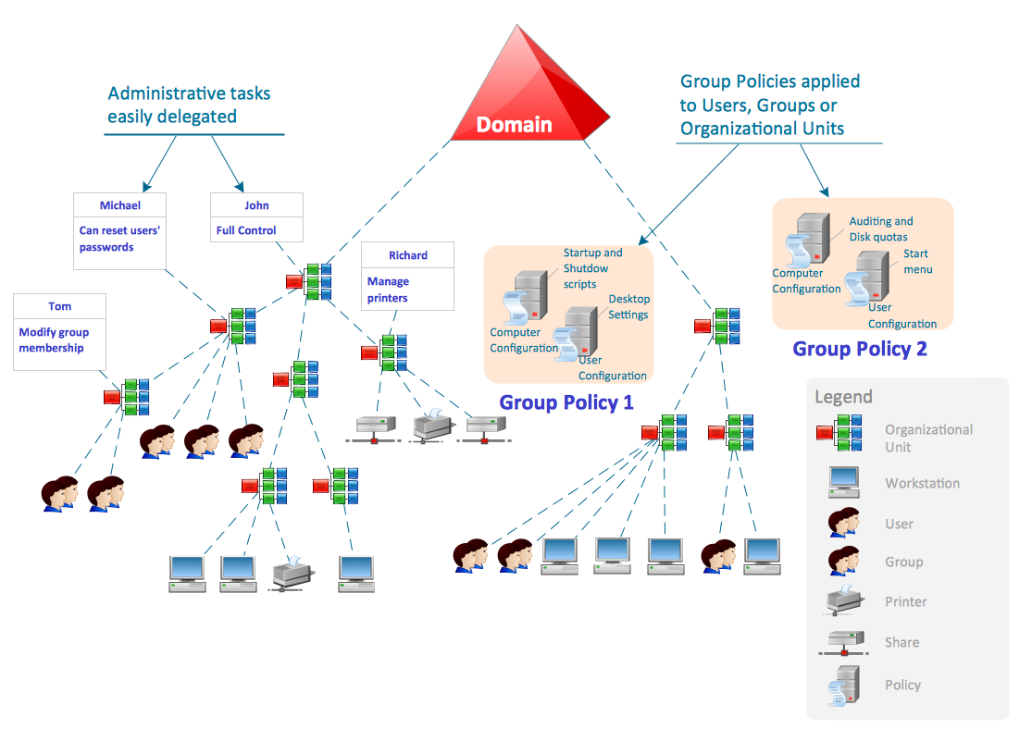
Active Directory model (Concept Draw, n.d.)

Slide 21
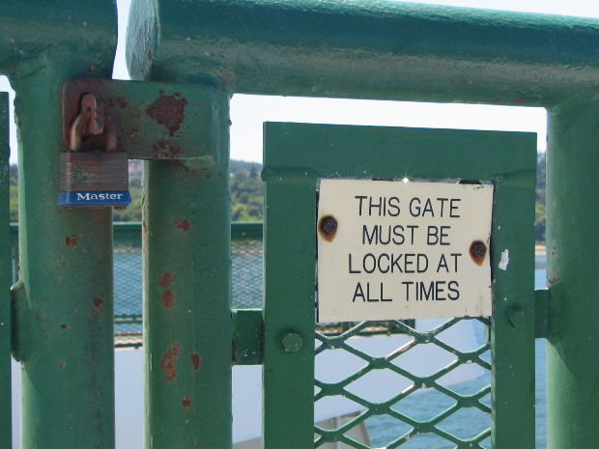
Advantages: Active Directory Domain Services
Native to Microsoft, included with Microsoft Server 20xx
As opposed to alternatives like Novell ZenWorks
Must purchase another software licence
User must authenticate before accessing computer and network resources with appropriate level of privileges
Security settings enforced consistently across all devices
(jppi, 2007)

Slide 22
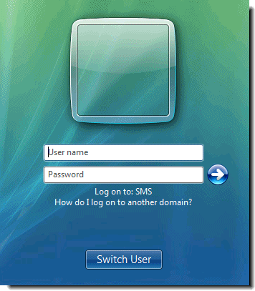
Vista domain login screen (Pietroforte, 2006)

Slide 23
User practices

Slide 24
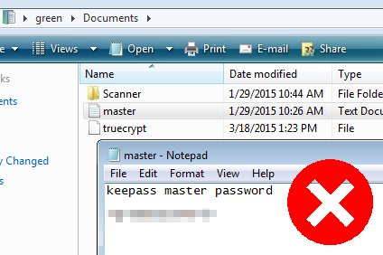
Security issue: Passwords in plaintext
A password was saved in plaintext in a user’s “My Documents” folder
An attacker could easily read password if gained access to computer

Slide 25
Recommend: Delete/destroy passwords in plaintext
Securely delete files containing passwords in plaintext
Include *.pdf, *.xls, *.ppt, etc. Not just *.txt files
Destroy any passwords written down on paper
ie. Sticky notes
Attackers can easily retrieve passwords on paper too
Prevent attacker from accessing easily readable media
Use of memorable passphrases will mitigate need for writing passwords down

Slide 26
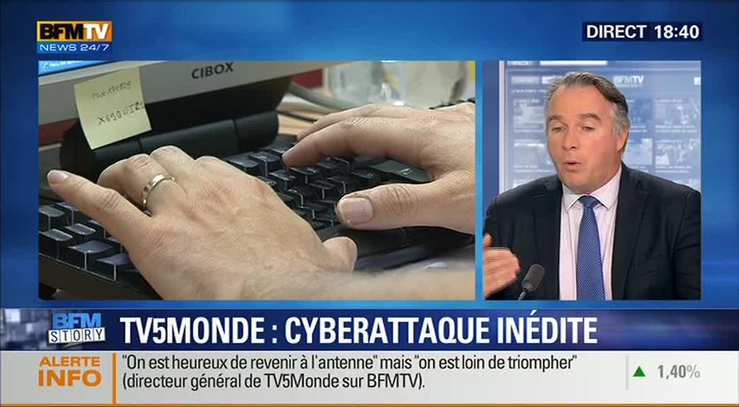
Sticky-note password disclosure on TV (@pent0thal, 2015)

Slide 27

Recommend: Passphrases
Oliver & Snowden (2015) discuss how to select a strong but memorable passphrase
Won’t have to write it down or save in plaintext

Slide 28
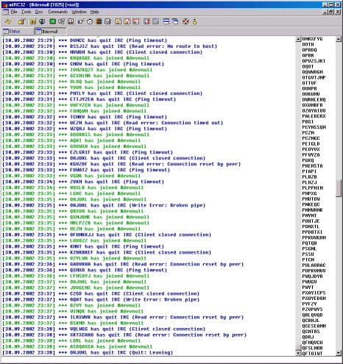
Security issue: mIRC Internet Relay Chat
Internet Relay Chat (IRC) share similar risks of malware propagation as email: Links, filesharing
Can also be used to control zombie hosts in botnet
Botnet controlled via IRC channel
(Carrera, 2002)

Slide 29
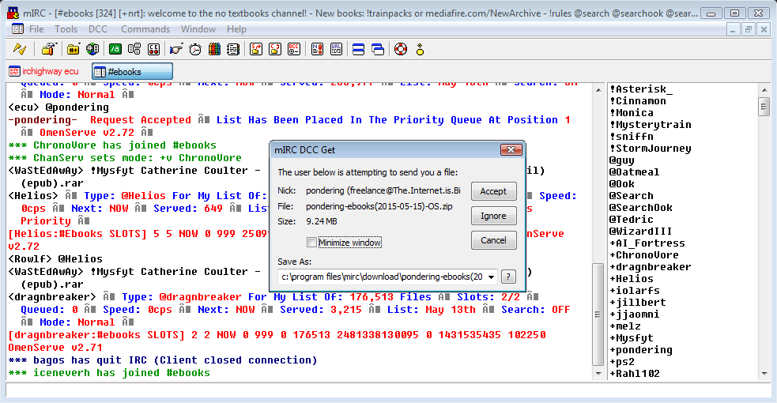
Recommend:
Remove mIRC
Deny use/installation of IRC clients in corporate environment
Mitigate risks of malware propagation
Mitigate ability to be controlled as botnet zombie
File sharing via IRC using Blue Ink’s mIRC client in VM

Slide 30
Summary

Slide 31
Anti-malware / patch management
Kaspersky Endpoint Security for Business Advanced 10.2
Both features scored highly in AV-TEST
Anti-malware and patch management in one software solution
User and device management
Active Directory Domain Services
Native to and included with Microsoft Server 20xx
No need to purchase another software licence
Manage security policies consistently across all devices/users

Slide 32
User practices
Never store password/s in plaintext files or on handwritten notes
Use passphrases
Deny use and installation of IRC clients like mIRC

Slide 33
References
@pent0thal. (2015). Another password spotted in the wild... [Twitter post]. Retrieved May 16, 2015, from https://twitter.com/pent0thal/status/586284074223984642
AV-TEST. (2013). Patch Management Solutions Test. Retrieved May 16, 2015, from http://www.av-test.org/fileadmin/pdf/avtest_2013-07_patch_management_english.pdf
AV-TEST. (2014a). Test antivirus software for Windows 7 - December 2014 | AV-TEST. Retrieved May 16, 2015, from http://www.av-test.org/en/antivirus/business-windows-client/windows-7/
AV-TEST. (2014b). Test Kaspersky Lab Endpoint Security for Windows 7 | AV-TEST. Retrieved May 16, 2015, from http://www.av-test.org/en/antivirus/business-windows-client/windows-7/december-2014/kaspersky-lab-endpoint-security-10.2-145015/
Carrera, E. (2002). Linux.Devnull. Retrieved May 18, 2015, from https://www.f-secure.com/v-descs/devnull.shtml
cohdra. (2005). 100_7363.JPG. Retrieved May 16, 2015, from http://www.morguefile.com/archive/display/41812
ConceptDraw. (n.d.). COMPUTER-AND-NETWORKS-Active-Directory-Domain-Services-diagram-Sample.png (1115×788). Retrieved May 16, 2015, from http://www.conceptdraw.com/solution-park/resource/images/solutions/active-directory-diagrams/COMPUTER-AND-NETWORKS-Active-Directory-Domain-Services-diagram-Sample.png
jppi. (2007). sw_locked_gate.jpg. Retrieved May 16, 2015, from http://www.morguefile.com/archive/display/129268
Kaspersky Lab. (2013a). About KASPERSKY ENDPOINT SECURITY FOR BUSINESS. Retrieved May 16, 2015, from http://media.kaspersky.com/en/business-security/endpoint-overview.pdf
Kaspersky Lab [Kaspersky Lab]. (2013b). Introducing Kaspersky Endpoint Security for Business (Advanced). Retrieved May 16, 2015, from https://www.youtube.com/watch?v=ctYWZxSVE-s

Slide 34
References
Microsoft. (2005a). Apply or modify password policy: Logon and Authentication. Retrieved May 14, 2015, from https://technet.microsoft.com/en-au/library/cc781633(v=ws.10).aspx?f=255&MSPPError=-2147217396#BKMK_3
Microsoft. (2005b). Assign user rights to a group in Active Directory: Active Directory. Retrieved May 14, 2015, from https://technet.microsoft.com/en-au/library/cc786658(v=ws.10).aspx
Microsoft. (2007a). Active Directory Domain Services Overview. Retrieved May 18, 2015, from https://technet.microsoft.com/en-us/library/cc731053(WS.10).aspx
Microsoft. (2007b). Configure UAC settings via policy - Microsoft Reduce Customer Effort Center - Site Home - TechNet Blogs. Retrieved May 14, 2015, from http://blogs.technet.com/b/asiasupp/archive/2007/02/08/configure-uac-settings-via-policy.aspx
Microsoft. (2012). Password must meet complexity requirements. Retrieved May 14, 2015, from https://technet.microsoft.com/en-us/library/hh994562(v=ws.10).aspx
Microsoft. (n.d.). Screen Saver timeout. Retrieved May 14, 2015, from https://technet.microsoft.com/en-us/library/cc961876.aspx
Oliver, J., & Snowden, E. [LastWeekTonight]. (2015). Last Week Tonight with John Oliver: Edward Snowden on Passwords. Retrieved May 6, 2015, from https://www.youtube.com/watch?v=yzGzB-yYKcc
Pietroforte, M. (2006). The second worst new feature of Windows Vista - 4sysops. Retrieved May 18, 2015, from https://4sysops.com/archives/the-second-worst-new-feature-of-windows-vista/

